Slide 1
Data Observability with IBM Databand
Introduction Session
Adrian Houselander EMEA Brand Technical Sales – Data & AI
https://databand.ai/

Slide 2

Please Note
IBM’s statements regarding its plans, directions, and intent are subject to change or withdrawal without notice and at IBM’s sole discretion.
Information regarding potential future products is intended to outline our general product direction and it should not be relied on in making a purchasing decision.
The information mentioned regarding potential future products is not a commitment, promise, or legal obligation to deliver any material, code or functionality. Information about potential future products may not be incorporated into any contract.
The development, release, and timing of any future features or functionality described for our products remains at our sole discretion.
Performance is based on measurements and projections using standard IBM benchmarks in a controlled environment. The actual throughput or performance that any user will experience will vary depending upon many factors, including considerations such as the amount of multiprogramming in the user’s job stream, the I/O configuration, the storage configuration, and the workload processed. Therefore, no assurance can be given that an individual user will achieve results similar to those stated here.

Slide 3

Data observability is needed to create confidence in an organization’s data products. Data observability is achieved through operational monitoring of data pipelines.
Data Fabric / © 2022 IBM Corporation
Notes:
Purpose of this slide:
Primer to show that data observability ensures reliable data…but the status quo is [Next slide]
“If you are investing data technologies, dashboards, products, you might be hurting your business if the data that’s powering their investments is corrupted.”
“If the data is incorrect, then you’re hurting your business.”
“They data their accessing is trustworthy“

Slide 4
What is Data Observability?
A collection of activities and technologies that allow us to identify, troubleshoot, and resolve data issues in near real-time.
A data observability should not stop at describing the problem, it should also provide enough context to enable the engineer to resolve the problem.
Notes:
Data observability includes a collection of activities and technologies that allow us to identify, troubleshoot, and resolve data issues in near real-time. A data observability should not stop at describing the problem, it should also provide enough context to enable the engineer to resolve the problem.
While data observability is an emerging domain in data management, the problem that it addresses is not new. Data engineering teams are reactive to data problems. They only hear about issues when discovered by downstream consumers, such as business analysts or data scientists who are using data for various projects.
There are multiple reasons why the issues are not resolved quickly. Let me review the top 3 issues that we have seen with our customers.
The first one variety of tools that are used for data pipelines. This fragmentation makes it hard to discover and correlate problems
The second reason is the volume of data. Without automation, it’s impossible to monitor the quality of data for a large number of data sources.
And finally, even if data engineers add automation and set up alerts for data pipelines, lack of granularity can lead to an overwhelming amount of information which is not useful for taking actions. Another way to describe this it to say that the signal gets lost in the noise.

Slide 5








When data platform is ineffective, everyone is impacted 90% of 90% of enterprise data flows through data platform and engineering*
Data Analytics
Inaccurate
business analytics
Data Platform & Engineering
Data Product
Frustrated customers
from bad client facing data
Data Science
Underperforming
machine learning
*Gartner Data Engineering Essentials, Patterns and Best Practices | May 2021
Notes:
So, Allow me to share a view of the backstory into why we chose this approach and the reason that we're focused on the data providers in your organization.
The reason for this is that most if not all of the data within an organization is going to flow through this team
and typically, it flows through this team prior to arriving to the data consumers.
So its our position that we can upstream a lot of data issues by being more proactive and solving these issues prior to them landing at the data analyst or the data scientist' feet
The value here is in avoiding some of the challenges related to:
Underperforming machine learning models
or poor business analytics.
The third category we're seeing more and more, and frankly a growing segment with our clients is that is a lot of folks are reaching out to us because they're also trying to productize their data and expose it to the end customer.
So, we really try to focus on putting up sturdy guardrails and assuring there are no data pipeline issues before sending data out to a potential customer, and this has received a lot of interest from our customers.
Question: is this scenario of exposing data outside the organization a common pattern at your company, or is data largely consumed internally?

Slide 6












The “modern” data stack90% of
Data Sources
Data Lake
Data Warehouse
Apps, BI, ML
Data Providers
Data Platform & Engineering
Data Consumers
Data Analytics & Science

Slide 7



The root causes
Data engineers are reactive to data issues
Fragmented toolchain
Sources
Data Lake
Data Warehouse
Data Access
(Analysts, Scientists)
Explosion of data
?
Flooding of noise
Most data quality issues are
never discovered
Platform only learns about issues when reported by data consumers
After issues are reported, they take weeks to fix
Notes:
OK, so lets quickly walk through what we view as some of the challenges of not being proactive when it comes to data observability.
When data engineers are reactive in nature, the clients we speak with say:
if they are forced to rely on the data analyst or data scientists to discover data issues, this often means that data quality issues are never discovered.
In addition, when data issues are discovered and reported by the data consumers informing the data engineers….
We all recognize that Its not the end consumer's job to discover data issues and
their focus is analyzing data, creating models, etc.
The frequently results in data issues either not being resolved or resolved late.
We’ve also learned from our clients that there is a relationship between the amount of time it takes to discover data issues and the time it takes for data issues to be resolved.
A number of the data issues occur at the source and if they then move thru the entire pipeline undetected and aren't discovered until the end user observes the issues, this will result in longer time to resolution and is also more expensive to resolve.
The last thing I want to point out is when leading with a reactive approach, there can be a flood of noise when it comes to alerting and it can be difficult if you're receiving these alerts from all data problems
it becomes difficult to discern which alerts require immediate attention and a call in the middle of the night because of a critical pipeline vs. Alters that are a nice to know and can be resolved later.

Slide 8
The required solution
After Databand
Proactive Data Observability: Shift left and solve problems at the source
Standard metadata
collection
Sources
Data Lake
Data Warehouse
Data Access
CRITICAL
(Analysts, Scientists)
Visibility into all data flows, from source to target
Improve Mean Time To Detect (MTTD)
Discover issues in real time, early as ingest
Improve Mean Time To Resolve (MTTR)
Identify the cause of issues instantly
Improve data product quality
Enhance trust and consumer satisfaction
Ability to separate signal from noise
Notes:
So, we try to address these issues by resolving them earlier and closer to the source, and "shifting Left" (to steal a phrase from the software development world)
The outcome of this and where clients see value in Databand is the improvement of 3 core metrics.
MTTD issues –
often this is instantaneous in Databand. most alerts that fire are in real-time.
MTTR: Improving MTTR is all about helping the data platform team quickly walk thru the context of the problem, such as where the problem is occurring, and why is it occurring and then resolve it as quickly as possible.
the net result, and the overall outcome we're seeking with our solution.....
is to improve the overall quality of the data and drive trust with the consumers of the data.
Any questions, and does this align with the way your organization thinks about solving the problem as well?

Slide 9
5 steps to Data Observability
1. Pipeline execution
2. Pipeline latency
3. Data structure
4. Data content
5. Data validation
Is data flowing?
Is data arriving on time?
Is the data shape valid and complete?
Are there significant changes in the data profile?
Does the data content conform to how it is being used?
With Databand - No more surprises. Deliver trustworthy data.
Detect and resolve your data incidents faster than ever with Databand. The only proactive data observability platform that catches bad data before it impacts your business.
Databand’s proactive data observability platform empowers data platform/engineering teams to deliver reliable and trustworthy data.

Slide 10

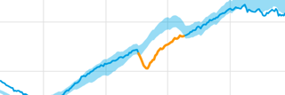







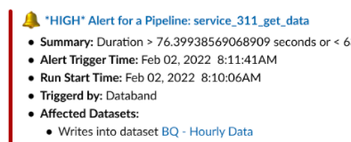
How Databand approached Observability
1. Automatically collect metadata
From key solutions in the “modern” data stack.
2. Build historical baseline
Based on common data pipeline behavior.
Collect
Profile
3. Alert on anomalies and rules
Based on deviations or breaches.
Databand
4. Resolve through automation
Create smart workflows that automatically remediate data quality issues and keep SLAs on track
Resolve
Alert
Notes:
The last slide I would like to share will serve as a pre-curser to the follow-on demo.
This slide walks us through the key components of our platform.
Since we’re very focused on observability of data in motion….the types of customers that have very good use cases that fit are those who are performing transformations before being loaded into the data warehouse
Our Most common customer is typically using some combination of spark with airflow.
And so, we can integrate with these technologies and many more as you see on the screen
Collect:
We will collect metadata from these sources and systems
Profile:
That metadata collection helps Databand create a historical baseline to understand what common pipeline behavior looks like
Note: We are not processing any of your actual data, rather we rely upon metadata to drive alerting.
Alert:
There are two types of alerting that our platform offers:
The most common alert is our out of the box anomaly engine
Based on our own AI, we can determine if a pipeline is deviating form standard behavior, and we can alert on those anomalies.
There is also an element of configurability that is provided…..and you can adjust the sensitivity of our anomaly engine if you are seeing to many or too few alerts.
The other flavor of alerting we offer are very specific custom rules or validations that you may require
As an example, if you know that within a dataset, the values of a particular column should fall between 5 and 10, you have the option to hard-code that into the system and have us alert you if out of range
The last piece of the platform is how can we continue to help our customers improve their MTTR metric by creating smart workflows to help remediate or solve some of these issues,
Any questions?
Based on what you’ve heard today, Is there anything u want us to discuss in more detail or drill down on in the demo?

Slide 11
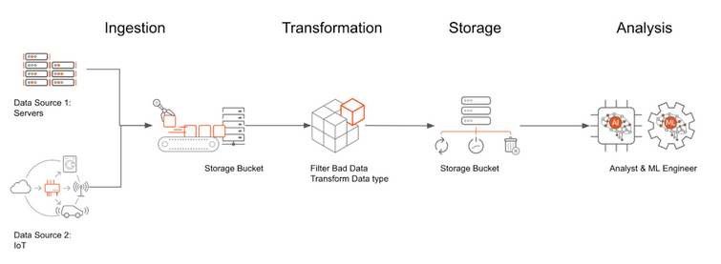
Data pipelines
Data pipeline is a generic term that describes the process of moving data between data sources
While in most cases data pipelines performing ETL tasks, a data pipelines can move data without transformations
Data pipelines can be implemented in a variety of programing languages, technologies, and tools
Languages: Python, Java, Scala, SQL
Technologies: Spark
Tools: dbt, DataStage and others
DAG – a Directed Acyclic Graph, which models each task and the dependencies between them.

Slide 12
Data Pipelines and Workflow managers
Following 30 years of enterprise scheduling more dynamic tooling is now required
An explosion of new tools for orchestrating task and data workflows
Growth of open source (specifically Hadoop & streaming) launched new capabilities (Oozie, Nifi)
Some tools have become de-facto choice - Apache Airflow* is both the most popular tool with the broadest range of features
Hyperscalers have introduced tooling either as part of a data platform, or as an ETL/ELT capability (some are rebadging of Airflow)
Examples include Azkaban*, dbt*, Redshift*, Snowflake*, BigQuery*, Python*, Spark* and MLFlow*
Some tooling provides its own scheduling i.e. DataStage*
* = Databand integration
https://docs.databand.ai/docs/tracking-pipeline-metadata

Slide 13

Workflow engines
Workflow engines are used to orchestrate execution of tasks
Many types of workflows are supported by generic operators, not just ETL
Examples of workflows: ETL, MLOps, DevOps
Examples of workflow engines
Airflow, Kubeflow, Luigi, MLFlow and others
Airflow is one of the first and one of the most generic workflow engines
Airflow is one of the first (open source) and one of the most generic workflow engines
Notes:
Data pipelines with Airflow book: https://learning.oreilly.com/library/view/data-pipelines-with/9781617296901/ (use IBM SSO)

Slide 14
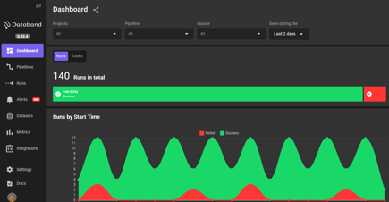
Development and deployment of data pipelines
Discovery questions
Create a Python data pipeline
Databand
Create a Spark data pipeline
Create DAGs in a Python IDE
Deploy DAGs in Airflow
Create a dbt data pipeline
Create any other data pipeline

Slide 15
Discovery session
Discovery session questionnaire
Collect
Top questions we ask:
Which data pipeline and orchestration technologies do you use? Examples: AirFlow, Python data pipelines, Spark data pipelines, dbt
How do you assess quality of your data pipelines?
How do you verify that your ingestion processes are delivering the right data?
Do you trust that your data ingestion framework is working?
What do your data teams do when issues are found during ingestion? How long does it take to pinpoint and resolve them?
Profile
Databand
Resolve
Alert

Slide 16
Databand Integrations
Supported Languages
Python
Java
Scala
Apache Spark
AWS EMR
GCP Dataproc
Local Spark
Databricks
Qubole
Any Spark server via Apache Livy
Tracking Databases
Amazon Redshift
Snowflake
Tracking BigQuery
More to come
Tracking Apache Airflow
Integrating with Standard Apache Airflow Cluster
Integrating Amazon Managed Workflows Airflow
Integrating Google Cloud Composer
Integrating Astronomer
Tracking Other Orchestrators
Azkaban
DBND
Luigi
Tracking Other Trackers
MLFlow
https://docs.databand.ai/docs/all-integrations

Slide 17
Databand integration
Pipeline implementation and deployment | Databand integration | Additional details
Spark (i.e Databricks) | No code (optional SDK) | Configuration in a Spark cluster – Databand provides a listener
Airflow (all pipelines) | No code for pipeline status, SDK for dataset monitoring
Python, PySpark, Java, Scala without a workflow engine | SDK for pipeline status and dataset monitoring
dbt without Airflow | No code for pipeline status, SDK for dataset monitoring
DataStage * | No code | Supported for DataStage Next Gen. Configuration in Cloud Pak for Data

Slide 18
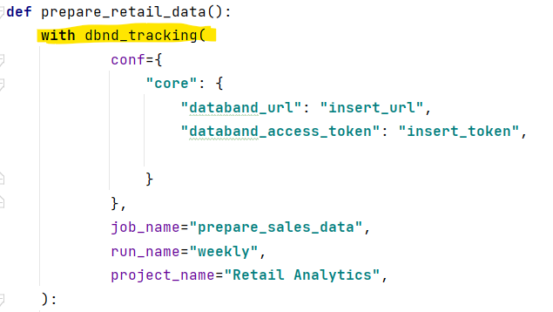
Databand SDK
Key steps
Start monitoring
Track pipeline steps
Track datasets

Slide 19
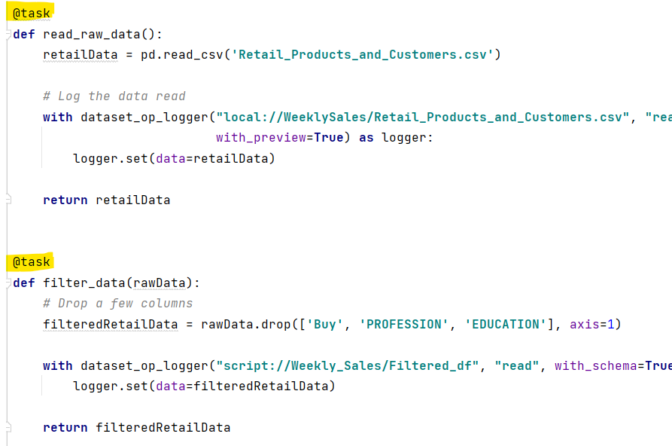
Databand SDK
Key steps
Start monitoring
Track pipeline steps
Track datasets

Slide 20
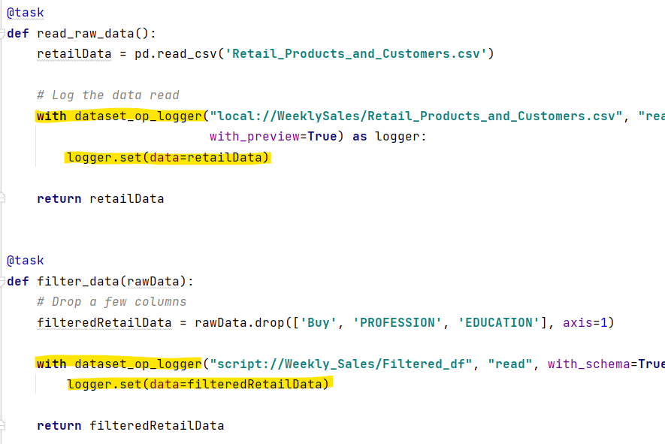
Databand SDK
Key steps
Start monitoring
Track pipeline steps
Track datasets

Slide 21
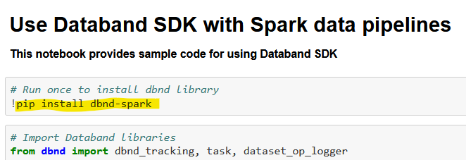
Spark Integration
Databand supports SDK and no-code integration with Spark runtime
SDK integration is the same as the Python integration reviewed in the previous section
The only difference is the library that’s used: dbnd-spark
No-code integration for dataset tracking:
Databand can capture Spark I/O operations. Databand Query Execution listener will capture any read/write operation performed by spark and will track the following metrics: data path, schema, and rows count as a dataset operation.

Slide 22
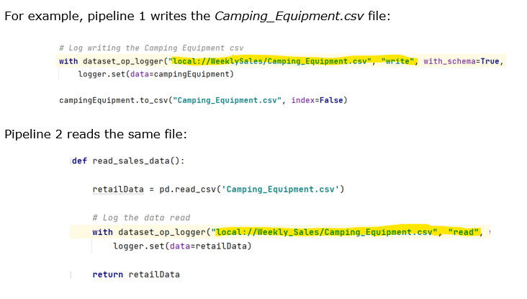
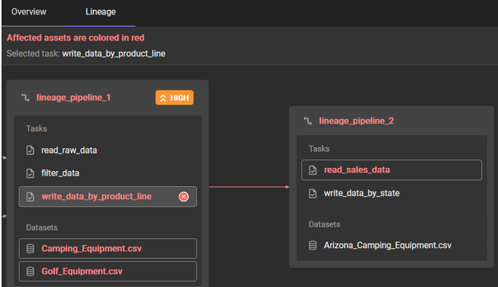
Lineage
Lineage is generated based on the dataset names provided in the logger calls
Any value can be provided for the name, but the recommendation is to make it as close to the dataset path as possible to simplify troubleshooting, for example a DB2 table name can be “db2://bludb/sales/camping_equip”

Slide 23
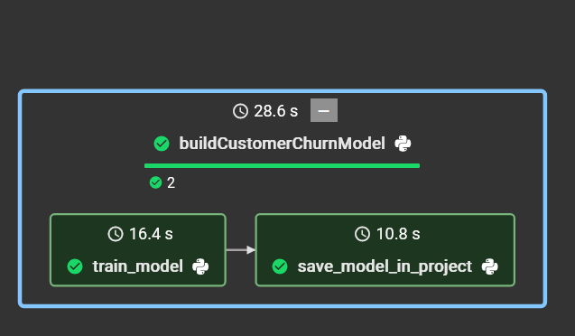
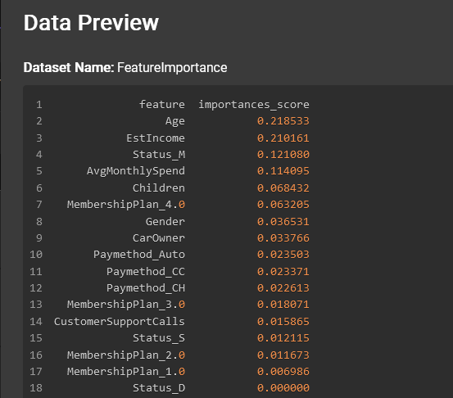

Monitoring other pipelines
While Databand is primarily used to monitor data pipelines, the SDK can also be used to monitor Machine Learning pipelines.
Examples of monitoring
Model building or scoring pipeline status
Schema change in a model building pipeline
Schema change in a model scoring pipeline
Change in feature importance
Values below threshold in a model building pipeline.

Slide 24
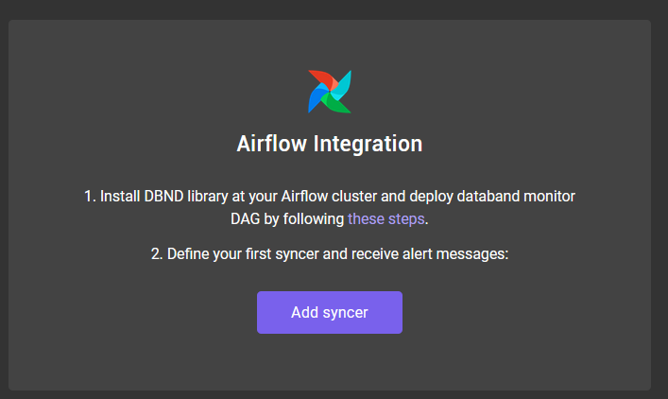
Airflow integration
Airflow syncer in Databand will monitor pipeline status
No code required
For monitoring datasets
No code for Spark pipelines (Spark listener in a Spark cluster)
Logger API in all other pipeline types

Slide 25
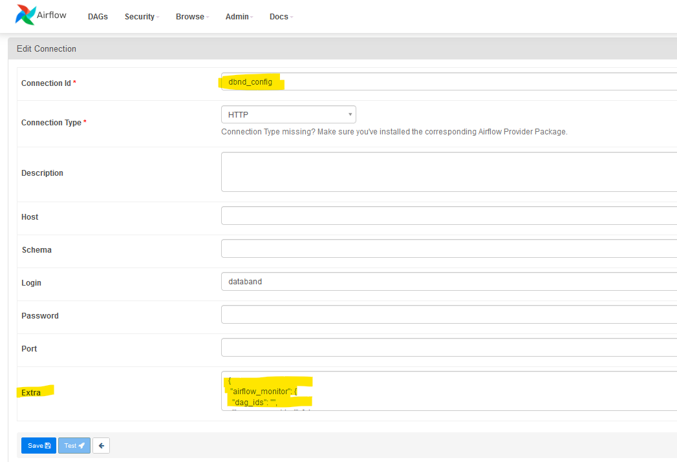
Airflow integration
Integration steps
Install the Databand SDK in the Airflow cluster
Add the Databand monitoring DAG (provided by Databand)
Configure a syncer in Databand UI. When creating a syncer, capture the connection details (will be entered in the next step)
In Airflow, create a connection to Databand, and paste the details from the previous step
Enable the monitoring DAG in Airflow (disabled by default)
Test connection to Airflow.
These steps are captured in Databand documentation.

Slide 26
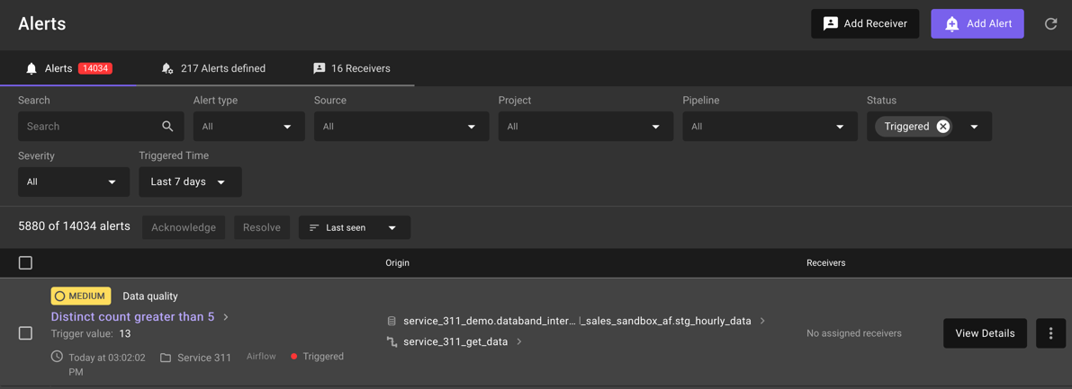
Alerting
Alerts can be defined and automatically notify required teams
Email, slack, pager-duty
Alerts against pipeline, multiple pipelines from a source, data availability, data quality

Slide 27
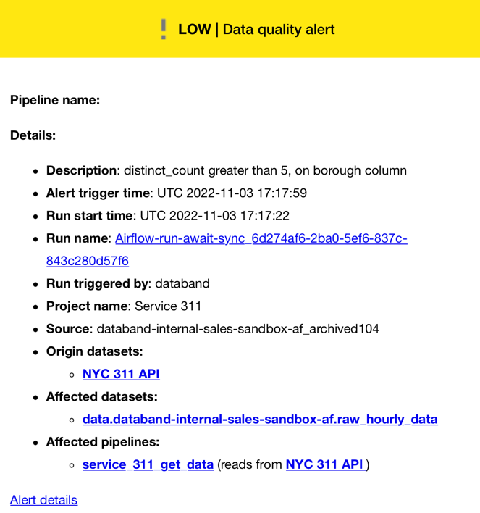
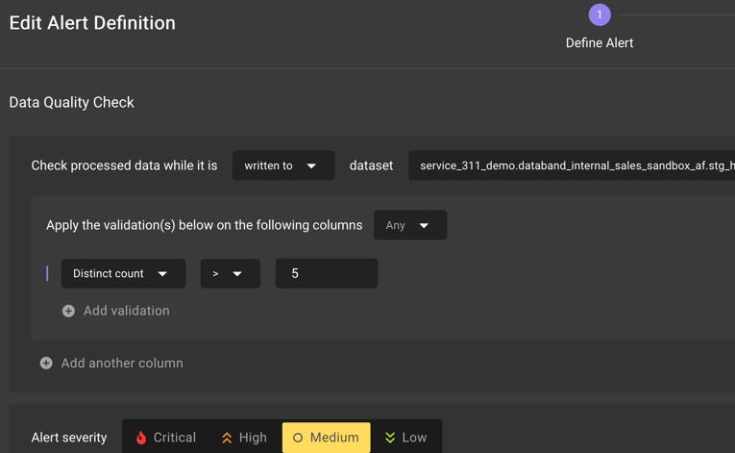
Alerting

Slide 28
Data Observability Demo
Process quality
Monitor jobs (DAGs) running in Airflow clusters
Perform impact analysis
Collect
Profile
Data quality
Investigate schema changes
Review data shape
Databand
Resolve
Alert
Configuring data observability
Configuration in Databand
Configuration in Airflow

Slide 29
Take Away - How Databand.ai uniquely delivers data observability to drive business outcomes
Unique capability of Databand.ai’s solution
Collect data pipeline metadata across key solutions in the modern data stack (Airflow, dbt, Databricks, etc)
Build historical baselines on data pipeline behavior
Detect and alert on relevant anomalies (separate signal from noise) as the data pipelines run
Automation to resolve anomalies through workflows to trigger changes without miss the delivery SLA
Resulting in
Improved Mean Time to Discovery – detect issues in real time as pipeline execute instead of reacting after they finish
Improved Mean Time to Repair – contextual metadata collected helps focus data engineers on the source of the problem rather then debugging where the problem resides
Improve data quality – enhance reliability and data delivery SLAs - provide visibility into pipeline quality issues that would otherwise go undetected

